Slide 1
CS 551
Spring 2025

Slide 7
Will it compile?

Slide 8
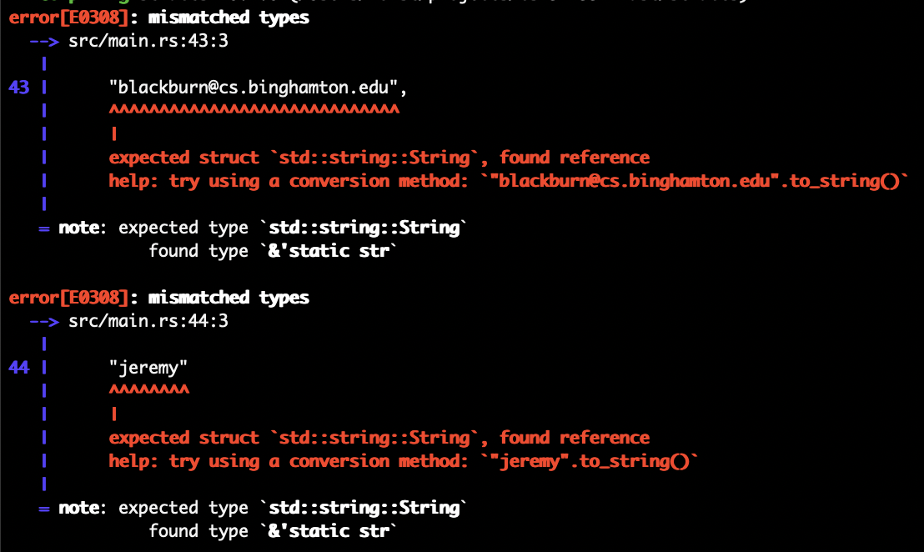
Will it compile?

Slide 11
Making these strings instead of &str means that they are heap allocated and subject to ownerships rules

Slide 12
This is a deliberate choice, which ensures that instances of the struct will own the data and never a possibly invalid reference

Slide 13
Lifetimes…
We will hit it later, but we gotta cover the basics first.
This is a deliberate choice, which ensures that instances of the struct will own the data and never a possibly invalid reference

Slide 14
What about &str?
Change the Strings to &str
Welcome to lifetimes ☺

Slide 15
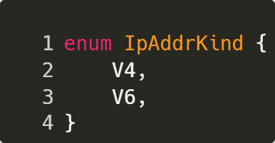
Enums
Give you a way to have certain variants
What’s a variant?
A value that is one of a defined set of values
What kind of situations does this make sense?

Slide 16
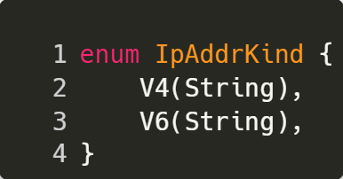
Enums
An enum variant can contain data!
Super relevant!

Slide 17
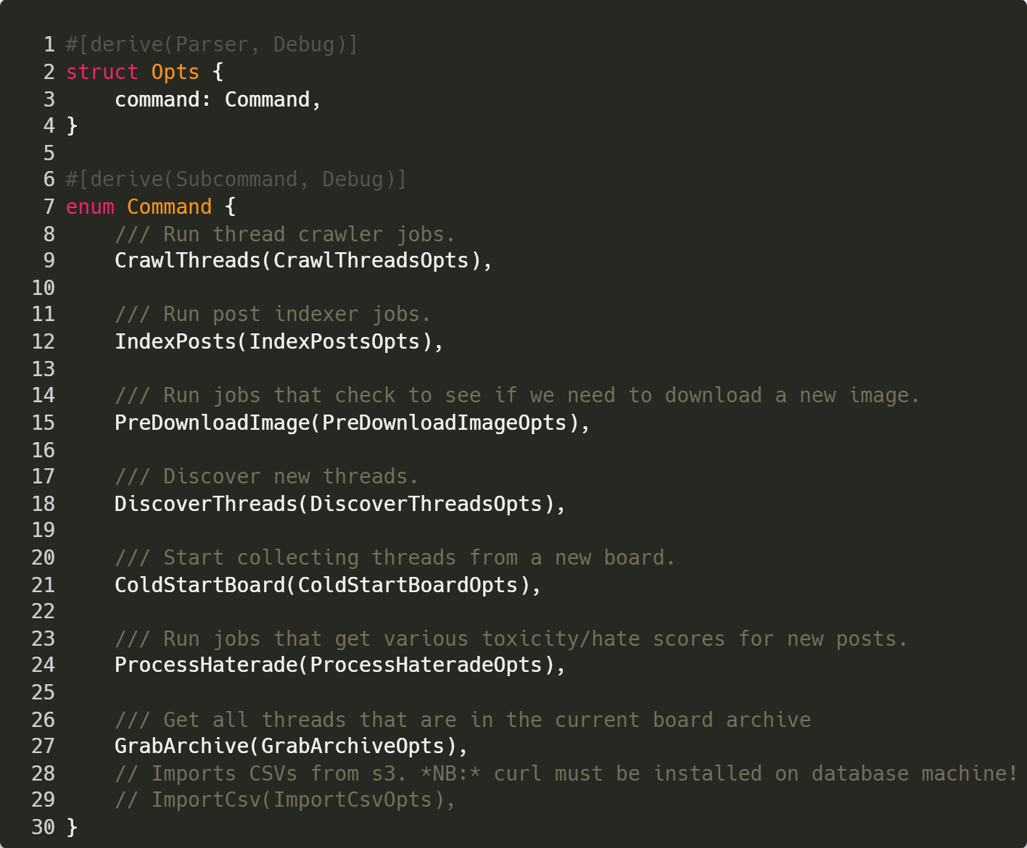

Slide 18
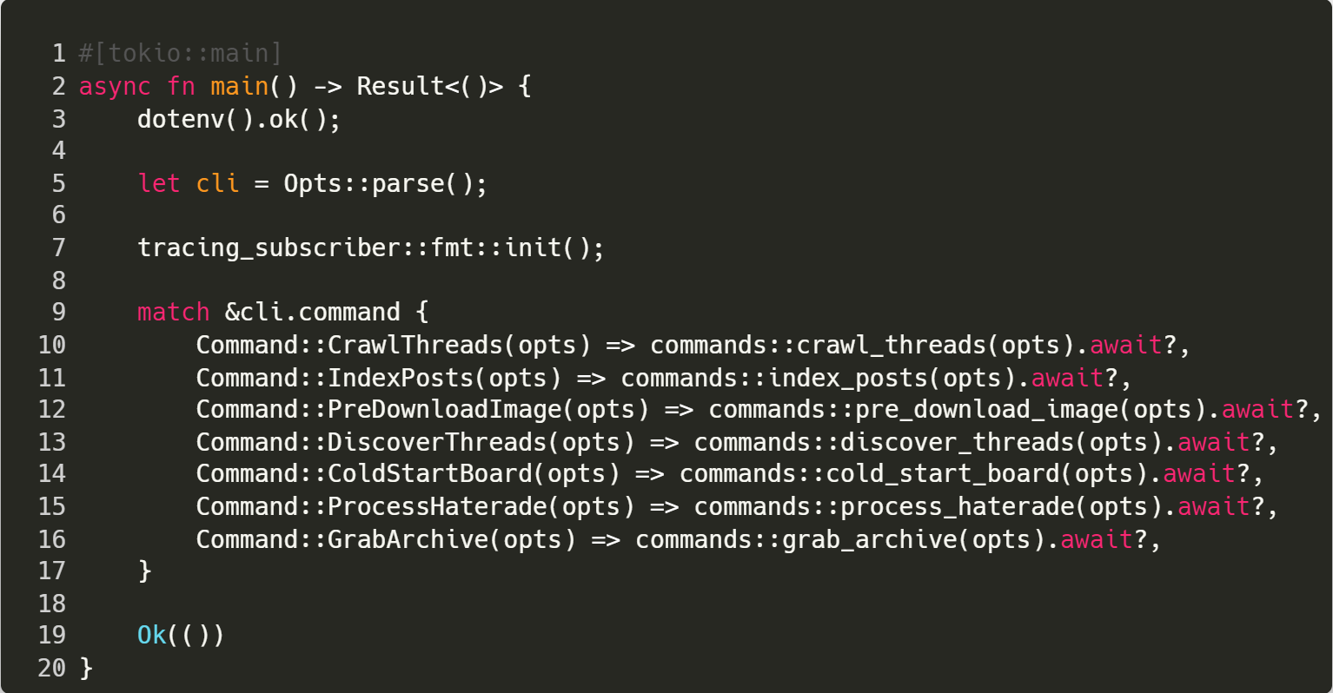

Slide 19
Collections

Slide 20
Vec<T>
Probably the most commonly used collection type
Gives you basic list behavior
Growable
On the heap
Can only store values of a single type T

Slide 21
Vec<T>
Probably the most commonly used collection type
Gives you basic list behavior
Growable
On the heap
Can only store values of a single type T
Why not just an array?

Slide 22
Vec<T>
Array size has to be known when it’s created
Probably the most commonly used collection type
Gives you basic list behavior
Growable
On the heap
Can only store values of a single type T

Slide 24
Here we are defining the type T that this vector will contain.

Slide 25
Then we simply call the new function associated with the Vec type

Slide 26
Vec has a variety of methods defined on it. The typical stuff you might expect

Slide 27
We can use the debug formatter to get a decent ”internal representation” of an instance

Slide 28
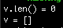
We can use the debug formatter to get a decent ”internal representation” of an instance

Slide 29
Vec<T>
Vecs can grow
If you want to add an element to a Vec, you can use the push(item) method
Note that your vector must be mutable!

Slide 31
There is a vec! macro that makes it a bit quicker to initialize a vector

Slide 32
We just push() a new value to the Vec

Slide 33
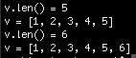

Slide 35
We can access vector elements like an array

Slide 36
Could also use v.get(index)
Which would return None if index is outside v’s bounds

Slide 37
Will it compile?

Slide 38
It compiles!

Slide 40
Will it compile?

Slide 41
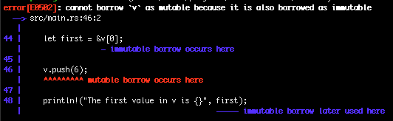
Will it compile?

Slide 42
Remember reference rules:
Can’t have mutable and immutable reference to same value in same scope!

Slide 43
Iterating over items
Vec<T> is iterable
You can use the convention for i in &v
Can also do a bunch of other stuff
Mutability and borrow rules can make this a bit confusing
What should things look like if we want to modify the values in the Vec<T>?

Slide 44
Iterating over items
Vec<T> is iterable
You can use the convention for i in &v
Can also do a bunch of other stuff
Mutability and borrow rules can make this a bit confusing
What should things look like if we want to modify the values in the Vec<T>?

Slide 46
Iterating over items
Vec<T> is iterable
You can use the convention for i in &v
Can also do a bunch of other stuff
Mutability and borrow rules can make this a bit confusing
What should things look like if we want to modify the values in the Vec<T>?

Slide 47
Iterating over items
Vec<T> is iterable
You can use the convention for i in &v
Can also do a bunch of other stuff
Mutability and borrow rules can make this a bit confusing
What should things look like if we want to modify the values in the Vec<T>?

Slide 48
Iterating over items
Vec<T> is iterable
You can use the convention for i in &v
Can also do a bunch of other stuff
Mutability and borrow rules can make this a bit confusing
What should things look like if we want to modify the values in the Vec<T>?

Slide 50
Will it compile?

Slide 51
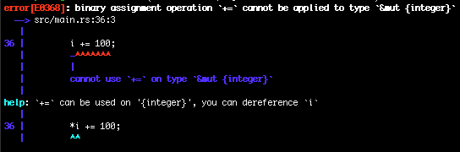
Will it compile?

Slide 53
Here we are going to get out a reference for an i32

Slide 54
We can’t really increment a reference itself

Slide 56
Instead we need to dereference the variable with * to get to the actual value

Slide 57
Vec<T>
Vectors can only contain a single type, but that is annoying
Reality is that being able to store multiple types can make our lives easier
How might we do this?
Rusts’s type system is super strong
Remember that enum variants can contain a value!

Slide 59
Our enum type will be MultiValue

Slide 60
It will have three variants

Slide 61
Each variant has a value of a certain type associated with it

Slide 64
We declare a Vec contains MultiValue variants

Slide 65
We are adding three different MultiValue values to v

Slide 66
Remember that each variant of MultiValue has a value associated with it!

Slide 67
Now we can pattern match on the variants

Slide 68
Note that this pattern is putting the value of whatever is in the variant into a variable named val

Slide 69
The variable name val is not meaningful in and of itself
We could have made it x or value or any valid variable name

Slide 70
Vec<T>
There are a ton of operations defined on Vecs
push(), pop(), len(), is_empty(), remove(), remove_item(), etc.
See https://doc.rust-lang.org/std/vec/struct.Vec.html
You can also get slices of Vecs

Slide 71
Strings
Strings are collections!
Collections of char
How many bytes is a char in Rust?
Four bytes (32 bits)

Slide 72
Strings
Strings are collections!
Collections of char
How many bytes is a char in Rust?
Four bytes (32 bits)

Slide 73
Strings
Strings are collections!
Collections of char
How many bytes is a char in Rust?
Four bytes (32 bits)

Slide 74
Strings
Strings are collections!
Collections of char
How many bytes is a char in Rust?
Four bytes (32 bits)

Slide 75
Hash Maps
Hash maps let you associate a key with a value
Pretty much every language has a Hash Map type included these days
In Python these are dicts()
In Ruby they are hashes

Slide 77
HashMap is in the std::collections crate

Slide 78
We can instantiate like normal

Slide 79
We can insert()

Slide 80
Rust will infer the key and value types from this

Slide 81
We can deconstruct each item in the hash to it’s key and associated value

Slide 82
Updating an entry
Just insert over the same key
Often times you only want to insert only if a key doesn’t exist
Hash Map has a special API for this

Slide 84
entry() returns an Entry instance

Slide 85
Entry has the or_insert() method defined on it

Slide 86
Returns a mutable reference to the value of the corresponding Entry’s key iff the key exists

Slide 87
If the key does not exist, it inserts it into the Hash Map and returns a mutable reference to new value

Slide 89
There are lots of tricks you can do…
iterator.zip(IteratorToZip)
When takes each of the items in Iterator and creates a tuple with a corresponding value from IteratorToZip
Iterator.collect()
Transforms an iterator into a collection
map(|instance_val| { expression } )
Performs a mapping of each value in an iterator

Slide 92
For each value in v.iter(), we loop through, putting the value into a temporary variable named temp

Slide 93
We add 50 to each value

Slide 94
map() will return a Map type.
Note that the map won’t be executed unless you do do something with it

Slide 95
map() will return a Map type.
Note that the map won’t be executed unless you do do something with it

Slide 96
When we call collect() on the Map, it is transformed into a collection
(a Vec<i32> as specified)

Slide 97
When we call collect() on the Map, it is transformed into a collection
(a Vec<i32> as specified)

Slide 98
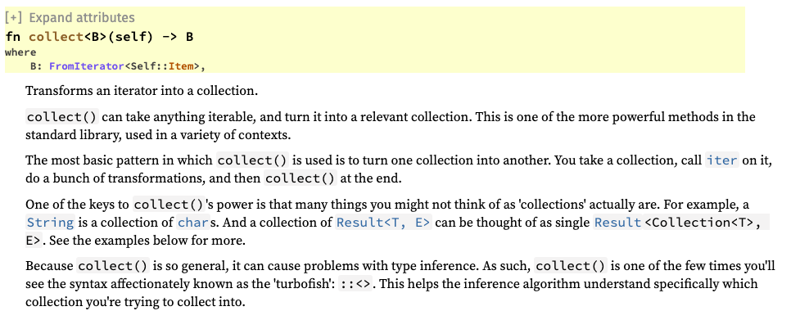

Slide 99
Read the docs!
The Iterator trait is the most useful way to deal with collections
Read the docs: https://doc.rust-lang.org/std/iter/trait.Iterator.html

